Slide 1
Web Technologies
Lecture # 5 : HTML Frames

Slide 2
Objectives
Create/control appearance & placement of frames
Control the behavior of hyperlinks on pages with frames
Use reserved target names to specify a target for a hypertext link
Browsers that support frames and by those that do not
Create and implement floating frames

Slide 3
Advantages to Using Frames
flexibility in design
information in different Web pages
remove redundancy.
site easier to manage.
update only a few files rather than the whole.
Web designers create both framed and non-framed versions for a Web site and give users the option of which one to use.

Slide 4
Disadvantages to Using Frames
The browser has to load multiple HTML files
  increasing wait time
Some older browsers cannot display frames.
Some users do not like using frames.
Some web authors feel that frames are too constricting.
Frames can use up valuable screen space.
The source code is hidden.

Slide 5
Creating a Frame Layout
The <frameset> tag is used to store the definitions of the various frames in the file. These definitions will typically:
  include the size and location of the frame
  include the Web pages the frames display
The <frameset> code does not include an opening and closing <body> tag.
  the reason for this is that this HTML file displays the contents of other Web pages; technically, it is not a Web page

Slide 6
Specifying Frame Size and Orientation
For frame layout
  use rows and cols attributes of <frameset>
frameset is defined by rows or columns, but not both.
Must choose to layout frames in either rows or columns.

Slide 7
The Frame Syntax
The syntax for creating a row or column frame layout is:
  <frameset rows=“row height 1, row height 2, row height 3, . . .”>
    row height is the height of each row
  or
  <frameset cols=“column width 1, column width 2, column width 3, . . .”>
    column width is the width of each column

Slide 8
Row and Column Sizes
Row and column sizes can be specified in three ways:
  in pixels
  as a percentage of the total size of the frameset
  by an asterisk (*)

Slide 9
Defining Rows and Columns Using (*)
Tells the browser to allocate any unclaimed space in the frameset to the particular row or column.
  <frameset rows=“160,*”>
  creates two rows of frames.
Specify at least 1 of the rows or cols of <frameset> with (*) to ensure that the frames fill up the screen.
You can use multiple asterisks.
The browser divides the remaining display space equally among the frames with the asterisks.
  <frameset rows=“*,*,*”>
  creates three rows of frames with equal heights.

Slide 10
Specifying a Frame Source
To specify a source for a frame, use the <frame> tag with the syntax: <frame src=“URL”>
The URL is the filename and location of the page that you want to load.
You must insert the <frame> tag between the opening and closing <frameset> tags.

Slide 11
Nesting <frameset> Tag
Remember that a frameset is defined by rows or columns, but not both.
To create frames using both rows and columns, one frameset must be nested inside another.
The interpretation of the rows and cols attributes changes slightly.

Slide 12
Controlling the Appearance of Your Frames
You can control three attributes of a frame:
  scroll bars
  the size of the margin between the source document and the frame border
  whether or not the user is allowed to change the size of the frame

Slide 13
Controlling the Appearance of Scroll Bars
By default, scroll bars are displayed when the content of the source page cannot fit within the frame.
You can override the default setting using the scrolling attribute.
The scrolling syntax is: <frame src=“URL” scrolling=“scrolling”>
  scrolling can either be “yes” (to always display scroll bars) or “no” (to never display scroll bars)

Slide 14
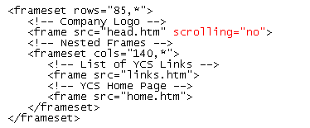
Removing the Scroll Bars from the Logo Frame
If the complete text cannot be displayed after removing the scroll bars from a frame, you will need to modify the frame margin.
set the scrolling attribute to “no” to remove the scroll bars
Notes:
Notes:
This example illustrates a common use of frames: displaying a table of contents in one frame, while showing individual pages from the site in another.

Slide 15
Controlling Frame Margins
The following should be consider for frame margins:
  the browser determines the amount of space between the content of the page and the frame border
  occasionally, the browser sets the margin between the border and the content too large
  the margin should be big enough to keep the source’s text or images from running into the frame’s borders
  the margin should not take up too much space, because you typically want to display as much of the source as possible

Slide 16
Specifying Margins Syntax
The syntax for specifying margins for a frame is: <frame src=“URL” marginheight=“value” marginwidth=“value”>
  marginheight is the amount of space, in pixels, above and below the content of the page in the frame
  marginwidth is the amount of space to the left and right of the page
If you specify only one, the browser assumes that you want to use the same value for both.

Slide 17
Controlling Frame Resizing
By default, users can resize frame borders
Web designers can freeze, or lock, frames, so that users cannot resize them.
The syntax for controlling frame resizing is: <frame src=“URL” noresize>
The noresize attribute

Slide 18
Working with Frames and Hypertext Links
By default, clicking a hyperlink within a frame opens the linked file inside the same frame.
You can display hyperlinks in many ways:
  in a different frame
  in a new window
  in the entire window
When you want to control the behavior of hyperlinks in a framed page, there are two required steps:
  give each frame on the page a name
  point each hyperlink to one of the named frames

Slide 19
Assigning a Name to a Frame
To assign a name to a frame, add the name attribute to the frame tag.
The syntax for this attribute is: <frame src=“URL” name=“frame_name”>
  frame_name is any single word you assign to the frame
  case is important in assigning names: “information” is considered a different name than “INFORMATION”

Slide 20
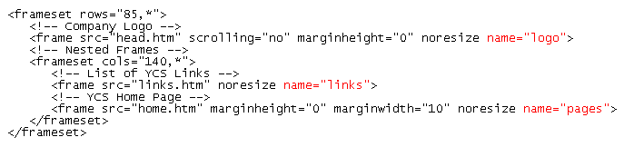
Assigning a Name to Each Frame
Once the frames are named, the next task is to specify the target frame for each hyperlink.
the frame name
Notes:
Notes:
This example illustrates a common use of frames: displaying a table of contents in one frame, while showing individual pages from the site in another.

Slide 21
Specifying a Link Target
You can use the target attribute to open a page in a specific frame.
The syntax for this is: <a href=“URL” target=“frame_name”>
  frame_name is the name you’ve assigned to a frame on your Web page
When a page contains dozens of hyperlinks that should all open in the same frame, HTML provides a way to specify a target frame for all the hyperlinks within a single page.

Slide 22
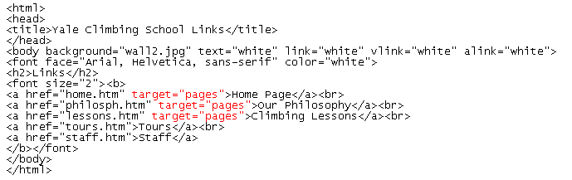
Assigning a Target to a Hyperlink
Make sure to test your hyperlinks.
the Web page will appear in the pages frame
Notes:
Notes:
This example illustrates a common use of frames: displaying a table of contents in one frame, while showing individual pages from the site in another.

Slide 23
Using Reserved Target Names
Reserved target names are special names that can be used in place of a frame name as the target.
They are useful in situations:
  where the name of the frame is unavailable
  when you want the page to appear in a new window
  when you want the page to replace the current browser window
All reserved target names begin with the underscore character ( _ ) to distinguish them from other target names.
Reserved target names are case-sensitive, they must be entered in lowercase.

Slide 24
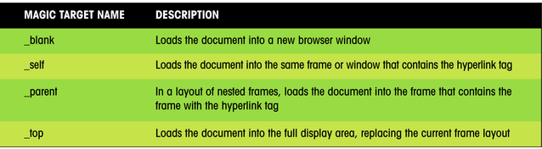
Reserved Target Names
This figure describes the reserved target names.
Notes:
Notes:
This example illustrates a common use of frames: displaying a table of contents in one frame, while showing individual pages from the site in another.

Slide 25
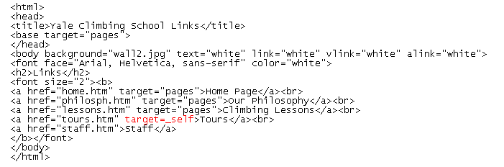
Using the _Self Target Name
You can use the reserved target name, _self, which overrides the target specified in the <base> tag and instructs the browser to open the page in the same frame that contains the hypertext link.
page will appear in the frame containing the hyperlink
Notes:
Notes:
This example illustrates a common use of frames: displaying a table of contents in one frame, while showing individual pages from the site in another.

Slide 26
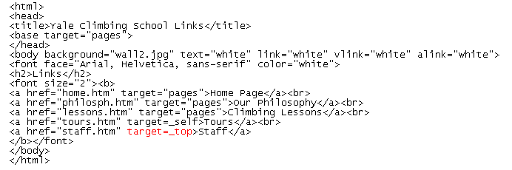
Using the _Top Reserved Target Name
To target a link to the full display area, you will use the _top reserved target name.
The _top target is often used when a framed page is accessed from another. It’s also used when you are linking to pages that lie outside your Web site altogether.
page will appear in the full display area
Notes:
Notes:
This example illustrates a common use of frames: displaying a table of contents in one frame, while showing individual pages from the site in another.

Slide 27
Frames and Browsers
To test your Web page, use a browser that does not support frames.
Another way of supporting browsers that do not display frames is to create a Web page that contains links to the framed and nonframed versions of your Web site.
It is important to correctly identify the target for hyperlinks within frames.
  by default, the target of the hyperlink will be the current frame
Use the _top target to hyperlinks to documents that lie outside of the Web presentation.

Slide 28
Working with Frame Borders
There are additional attributes you can apply to the <frame> tag that allow you to change border size and appearance. For example:
  you can remove borders from your frames to free up more space for text and images
  you can change the color of the frame border so that it matches or complements the color scheme for your Web site

Slide 29
Setting the Border Color
To change the color of a frame’s border, use the bordercolor attribute.
The attribute can be applied either to an entire set of frames, using the <frameset> tag, or to individual frames, using the <frame> tag.
The syntax for this attribute is:
  <frameset bordercolor=“color”>
  or
  <frame bordercolor=“color”>
  color is either a color name or a color value

Slide 30
Setting the Border Color Continued
Applying the bordercolor attribute to the <frameset> tag affects all of the frames and nested frames within the set.
If you apply the bordercolor attribute to a single <frame> tag, that particular color of the border changes in Internet Explorer, but in Netscape Navigator, all of the frame borders change.
View the page using different browsers and browser versions.

Slide 31
Setting the Border Width
Another way of modifying frame borders is to change their widths using the border attribute.
The border attribute can be used only in the <frameset> tag, and not in individual <frame> tags.
The syntax for the border attribute is: <frameset border=“value”>
  value is the width of the frame borders in pixels

Slide 32
The frameborder Attribute
Adding frameborder=“no” to a <frameset> tag removes the borders from the frames in your page.
  by removing the borders, more space for the text and images in each of the Web pages is created
Internet Explorer also supports the framespacing attribute, which has the same effect as the border attribute.
Netscape does not support the framespacing attribute.

Slide 33
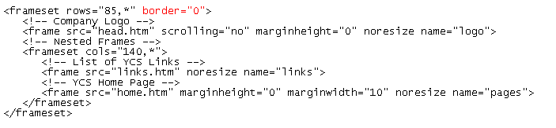
Removing the Frame Borders
Some Web designers prefer not to show frame borders in order to give the illusion of having a single Web page rather than three separate ones, while other Web designers believe that hiding frame borders can confuse users as they navigate the Web site.
setting the width of the frame border to zero has the effect of removing the border

Slide 34
Creating Floating Frames
Another way of using frames is to create a floating frame.
A floating frame, or internal frame, is displayed as a separate box or window within a Web page.
The frame can be placed within a Web page in much the same way as an inline image.

Slide 35
The Floating Frames Syntax
The syntax for a floating frame is: <iframe src=“URL” frameborder=“option”></iframe>
  URL is the name and location of the file you want to display in the floating frame
  the frameborder attribute determines whether the browser displays a border (“yes”) or not (“no”) around the frame
  in addition to these attributes, you can use some of the other attributes you used with fixed frames, such as the marginwidth, marginheight, and name attributes

Slide 36
Attributes Associated with the <iframe> Tag
This figure shows some of the other attributes associated with the <iframe> tag.
Attribute
Description
align="alignment"
How the frame is aligned with the surrounding text (use "left" or "right" to flow text around the inline frame.)
border="value"
The size of the border around the frame, in pixels
frameborder="type"
Specifies whether to display a border ("yes") or not ("no")
classid="URL"
The class identifier of the object
height="value"
width="value"
The height and width of the frame, in pixels
hspace="value"
vspace="value"
The horizontal and vertical space around the frame, in pixels
marginheight="value"
marginwidth="value"
The size of the internal margins of the frame, in pixels.
name="text"
The name of the frame
scrolling="type"
Specifies whether the frame can be scrolled ("yes") or not ("no")
src="URL"
The location and filename of the page displayed in the frame
Notes:
Notes:
This example illustrates a common use of frames: displaying a table of contents in one frame, while showing individual pages from the site in another.

Slide 37
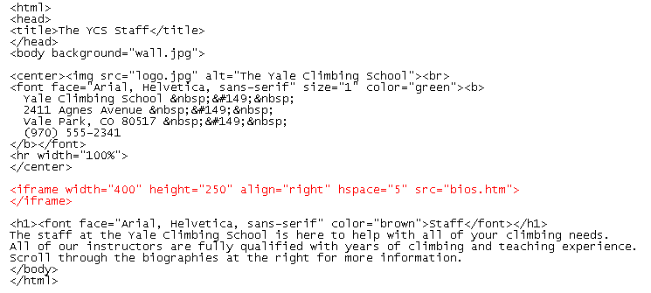
Creating a Floating Frame
HTML code to create a floating frame

Slide 38
Changing Web Page Content
When changing Web page content, you may want to reload or refresh the Web page:
  for Netscape, you will need to close and then open the file for the changes to the frames to take effect. Simply clicking the Reload button, your changes are not displayed
  for Internet Explorer 3.0 and above, in which you can view changes to the page by clicking the Refresh button

Slide 39
Frame Tricks - Example
Content
  Frames don't have to load HTML
    can put SRC="logo.gif", for example
    sometimes this helps eliminate margins
  Use <BASE TARGET="_top">
  Frames can contain frameset documents
    why? Allows change to part of the frameset

Slide 40
Frame Tricks - Example
Example
  main_fs.html
  <FRAMESET ROWS="50,*">
  <FRAME NAME="banner" SRC="banner.gif">
  <FRAME NAME="subframe" SRC="sub_fs.html">
  </FRAMESET>
  <NOFRAMES>
  <!-- frameless content -->
  </NOFRAMES>

Slide 41
Frame Tricks - Example
Example
  sub_fs.html
  <FRAMESET COLS="25%,*">
  <FRAME NAME="toc" SRC="contents.html">
  <FRAME NAME="main" SRC="main.html">
  </FRAMESET>
  <NOFRAMES>
  <!-- frameless content -->
  </NOFRAMES>

Slide 42
Frame Tricks - Example
Result
Dashed lines indicate "subframe"
banner
toc
main

Slide 43
Frame Tricks - Example
Reloading subframe
  in banner.html:
    <A HREF="orders.html" TARGET="subframe">
  results in:
banner
orders.html

Slide 44
Summary
  How to display multiple Web pages in a Web browser using frames,
  How to create a frame layout and specify the source document for each frame,
  How to control the behavior and appearance of each frame,
  How to specify which frame will contain the results of an activated hyperlink,
  How to support "frame-blind" browsers.
  Extensions supported by some browsers.

Slide 45
Thank You
Thank you

